Slide 1
Data and Analytics (Experimentation)

Slide 2
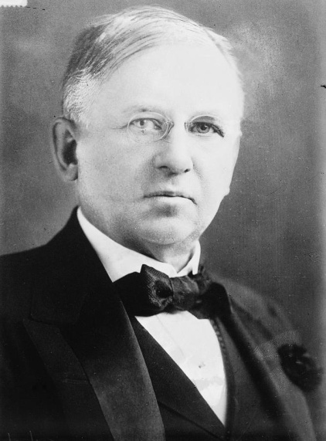
What Is Enabled by Digital?
“Half the money I spend on advertising is wasted; the trouble is I don't know which half ”--- John Wanamaker
Targeting (last lecture); experimentation and measurability (this lecture)
source: https://commons.wikimedia.org/w/index.php?curid=8358951
Q

Slide 5
Return on Investment
ROI = (gain attributable to investment – cost of investment) / cost of investment
Example 1 (warm-up)
Invest $2, with profit $2.50 attributable to investment
ROI = (2.5 – 2) / 2 = 0.5 / 2 = 25%
“Every $1 invested generates a return of $0.25”

Slide 6
Advertising ROI
ROI = (profit attributable to ad spend – ad spend) / ad spend
Example 2:
New business, $200 ad spend, $1200 sales (attributable to ads), $600 product cost
ROI = ((1200 – 600) – 200) / 200 = 400 / 200 = 200%
“Every $1 spent generates a return of $2”
Q

Slide 9
Advertising ROI
ROI = (profit attributable to ad spend – ad spend) / ad spend
Example 3
No ads
With ads (spend $200)
? sales, profit₁ = $?
6 sales, profit₂ = $600
We don’t know what is “attributable.”
Suppose would have 2 sales without ads. Then, ROI = (400 – 200) / 200 = 200 / 200 = 100%.
But we don’t know. Could be negative ROI.

Slide 10
A Real Problem; Connects to Targeting
Bad retargeting is costing marketers billions
Sales not incremental
83%
83%
of ecommerce marketers believe that some of the
sales they attribute to retargeting ad campaigns
would have occurred organically without advertising,
but only 28% have a way to prove it
28%
Why are retailers paying to drive revenue that’s already in
their pockets? It comes down to optimizing for the wrong
performance metrics.
Challenging to measure
Source: http://go.nanigans.com/retargeting-reality-2018/p/1
Q

Slide 13
Missing Counterfactual Information
ROI = (profit attributable to ad spend – ad spend) / ad spend
No ad
With ad (spend $200)
? sales, profit₁ = $?
6 sales, profit₂ = $600
Attributable to ad spend is the change in profit:
Δ profit = (profit₂ – profit₁)
But sales without exposure to ads are unobserved

Slide 14
A Counterview: It’s Straightforward
“ Measuring online sales impact of an online ad [ ] is straightforward: We determine who has viewed the ad, then compare online purchases made by those who have and those who have not seen it.”
M. Abraham, Harvard Business Review, April 2008

Slide 15
It’s really not straightforward
Targeted ad
Unreachable
Reachable
No ad
Ad
No ad
Ad
$$_{A}
$$_{C}
$$_{B}
$$_{D}
no
Q

Slide 18
An Intent Bias
Users who see the ad are different from users who do not; they searched for “online brokerage”
More intent on finding a brokerage than those who do not search
Unreachable
Reachable
No ad
Ad
No ad
Ad
$$_{A}
$$_{C}
$$_{B}
$$_{D}
Q

Slide 21
An Activity Bias
Users who see the ad are different from users who do not; they are online
More active than those who do not see the ad
Unreachable
Reachable
No ad
Ad
No ad
Ad
$$_{A}
$$_{C}
$$_{B}
$$_{D}

Slide 22
An Activity Bias at Yahoo
35 million users exposed on Yahoo network to ad for a services company
Typical user, on typical day is 0.08%
Fraction Who Search for Relevant Keywords
.0016
.0012
Fraction Searching by Group
.0008
.0004
-12
-8
-4
0
4
8
12
Days Relative to Ad Campaign Delivery Date
Treatment
Control
Source: Lewis, Rao, and Reiley’11

Slide 23
An Activity Bias at Yahoo
35 million users exposed on Yahoo network to ad for a services company
Typical user, on typical day is 0.08%. Ad: 0.16% searched brand-related terms
Ad: 0.156% Control (PSA): 0.148%
Fraction Who Search for Relevant Keywords
.0016
Activity bias: users who see ad are online
.0012
Fraction Searching by Group
Without the control group, Yahoo would overestimate effect
.0008
.0004
-12
-8
-4
0
4
8
12
Days Relative to Ad Campaign Delivery Date
Treatment
Control
Source: Lewis, Rao, and Reiley’11

Slide 25
A/B Experiments

Slide 26
What we want to measure
Targeted ad
Unreachable
Reachable
No ad
Ad
No ad
Ad
$$_{A}
$$_{C}
$$_{B}
$$_{D}
Average treatment effect on the treated

Slide 27
The Potential Outcomes Framework
 | No Ad Treatment 1 | Ad Treatment 2
User 1 | Y₁₁ | Y₁₂
User 2 | Y₂₁ | Y₂₂
User 3 | Y₃₁ | Y₃₂
User 4 | Y₄₁ | Y₄₂
… | … | …
Total
Reachable set
Y_{ik} = profit from user i in treatment k (a “potential outcome”)
Fundamental problem of causal inference: for each user i, we only know one of Y_{i1} or Y_{i2}

Slide 28

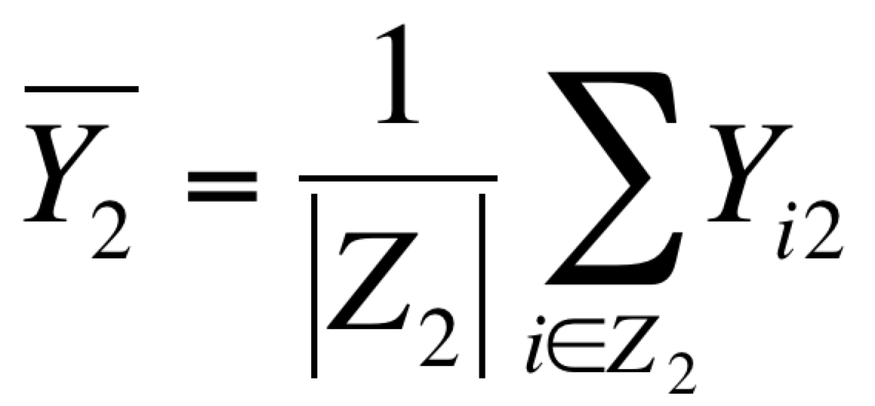
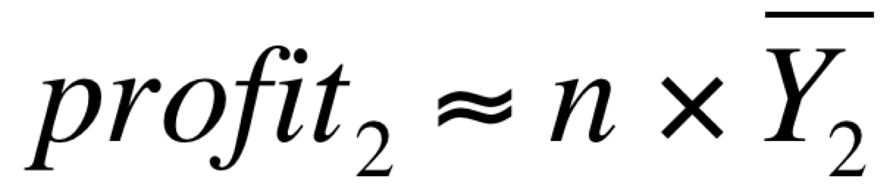
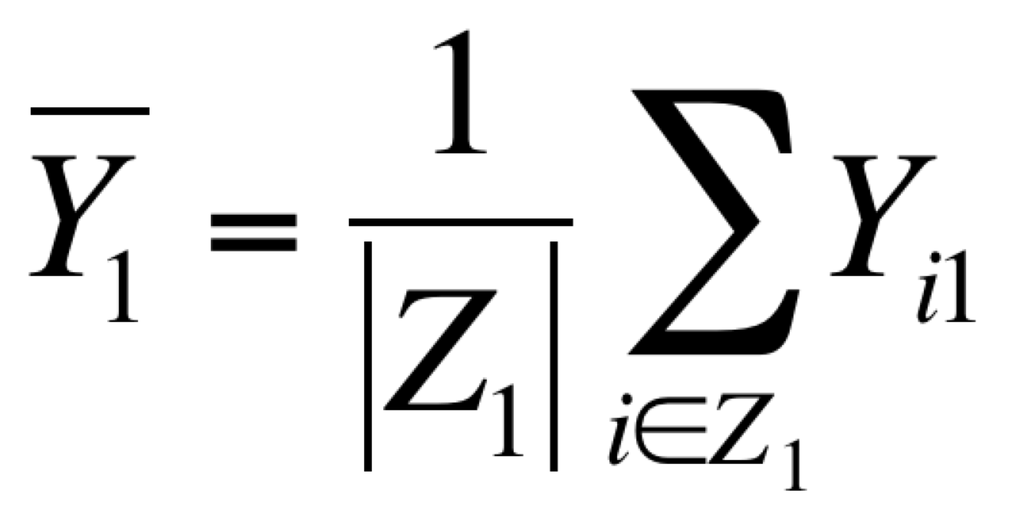
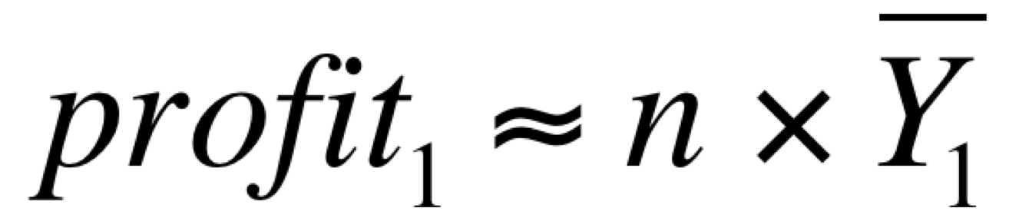
A/B Experiments
 | No Ad Treatment 1 | Ad Treatment 2
User 1 | Y₁₁ | Y₁₂
User 2 | Y₂₁ | Y₂₂
User 3 | Y₃₁ | Y₃₂
User 4 | Y₄₁ | Y₄₂
… | … | …
Total
Random assignment
Reachable set
For each user, flip a coin. Tails = no ad, Heads = ad
Estimate:
Z₁ = {1,4}. Z₂ = {2,3}
Source: https://justflipacoin.com/

Slide 29
A/B Experiments
 | No Ad Treatment 1 | Ad Treatment 2
User 1 | Y₁₁ | Y₁₂
User 2 | Y₂₁ | Y₂₂
User 3 | Y₃₁ | Y₃₂
User 4 | Y₄₁ | Y₄₂
… | … | …
Random assignment
Reachable set
Crucial that the users in each treatment “look the same” (e.g., gender, age, income, intent, online, …)
This is the role of randomization!
Source: https://justflipacoin.com/

Slide 30
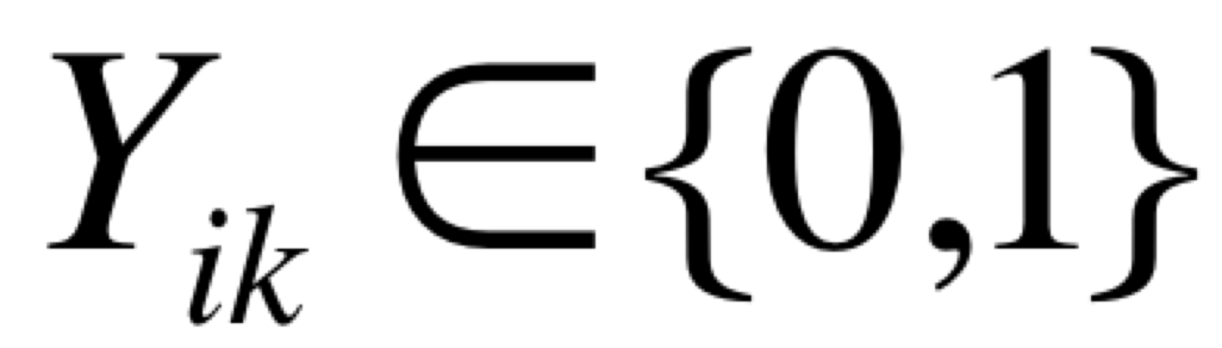
RCTs in Public Health
is person i healthy under treatment k?
Observational data
Experimental data
No exercise Treatment 1 | Exercise Treatment 2
Y₁₁
Y₂₁
 | Y₃₂
 | Y₄₂
… | …
No exercise Treatment 1 | Exercise Treatment 2
Y₁₁ | Y₁₂
Y₂₁ | Y₂₂
Y₃₁ | Y₃₂
Y₄₁ | Y₄₂
… | …
Population who chooses to exercise is different from those who do not A biased estimate!
Random assignment: an unbiased estimate of effect of exercise

Slide 32
Measuring the ROI for a Retargeting Campaign

Slide 33
Measuring ROI: Retargeting
Determine a targeted set of users 1, 2, …7
 | No Ad Treatment 1 | Ad Treatment 2
User 1 | Y₁₁ | Y₁₂
User 2 | Y₂₁ | Y₂₂
User 3 | Y₃₁ | Y₃₂
User 4 | Y₄₁ | Y₄₂
User 5 | Y₅₁ | Y₅₂
User 6 | Y₆₁ | Y₆₂
User 7 | Y₇₁ | Y₇₂
Targeted set

Slide 34
Measuring ROI: Retargeting
Determine a targeted set of users 1, 2, …7
Randomly assign users to “no ad” or “ad” treatment
 | No Ad Treatment 1 | Ad Treatment 2
User 1 | Y₁₁ | Y₁₂
User 2 | Y₂₁ | Y₂₂
User 3 | Y₃₁ | Y₃₂
User 4 | Y₄₁ | Y₄₂
User 5 | Y₅₁ | Y₅₂
User 6 | Y₆₁ | Y₆₂
User 7 | Y₇₁ | Y₇₂
Targeted set

Slide 35
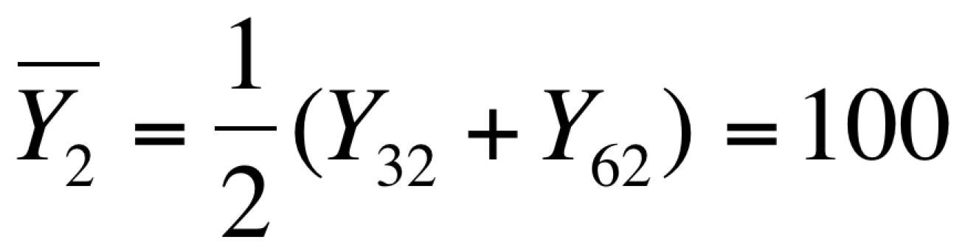
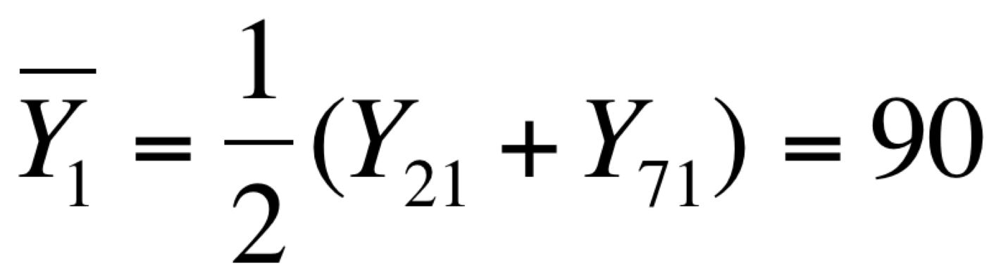
Measuring ROI: Retargeting
Determine a targeted set of users 1, 2, …7
Randomly assign users to “no ad” or “ad” treatment
 | No Ad Treatment 1 | Ad Treatment 2
User 1 | Y₁₁ | Y₁₂
User 2 | Y₂₁ | Y₂₂
User 3 | Y₃₁ | Y₃₂
User 4 | Y₄₁ | Y₄₂
User 5 | Y₅₁ | Y₅₂
User 6 | Y₆₁ | Y₆₂
User 7 | Y₇₁ | Y₇₂
For users in “no ad” treatment who can be shown an ad:
Targeted set
For users in “ad” treatment who can be shown an ad:
Users who can be shown an ad
Low ROI

Slide 36

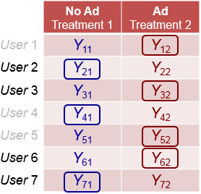


Implementing this: Ghost Ads
Targeted user
Measure Y_{i1}
Ad treatment
No Ad treatment
Ad treatment
No Ad treatment
Wins
Log
Ghost Ad = 1
Simulated Auction
Loses
Log
Ghost Ad = 0
Measure Y_{i2}
Include
Omit
Louboutin wins
Wins
Real Auction
Another ad wins
Another ad wins
Loses
Source: Johnson, Lewis and Nubbemeyer’17a

Slide 37
Average Treatment Effect on the Treated
Targeted ad
Unreachable
Reachable
No ad
Ad
No ad
Ad
Y₁
Y₂
ATET = E[Y₂ – Y₁]
ROI = (ATET – cost per ad) / cost per ad

Slide 38

Measuring ROI at a Midsize Retailer
2014 “ghost ads” experiment, for online sports and outdoor retailer
Retargeting campaign (browse, cart-no-purchase or ad-to-wishlist action)
Google Display Network, with a dynamic creative
Randomized: 30% “no ad”, 70% “ad”
source: Johnson, Lewis, Nubbemeyer’ 17a
17.2% increase in visits,11.9% increase in transactions, 10.5% increase in revenue; a positive ROI

Slide 39
184 Ad Spend Experiments
Incremental conversions with 95% confidence intervals
Google Display Network
184 experiments June–September, 2015
Median lift 8.1%
53/184 significant, positive lift
200
100
Conversions Lift (%)
0
-100
0
50
100
150
Experiment
Source: Johnson, Lewis, Nubbemeyer’17b

Slide 41
Measuring the ROI for Sponsored Search

Slide 42
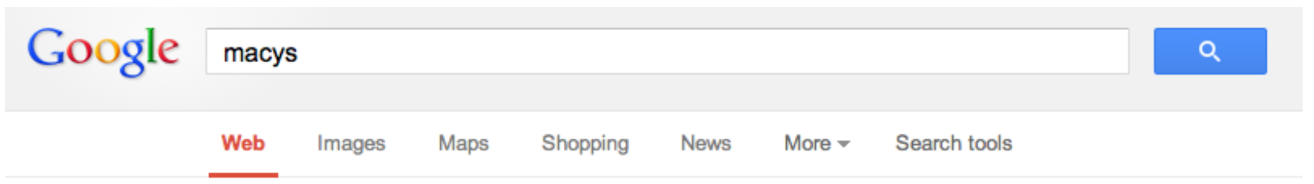
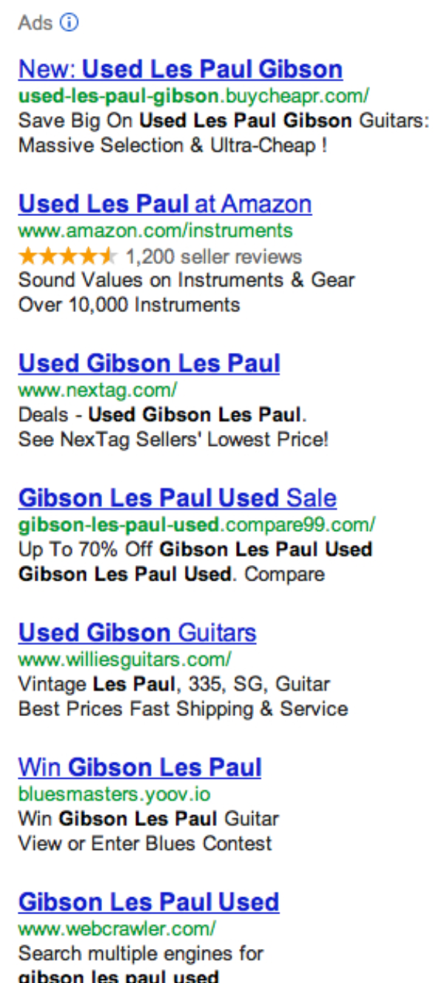
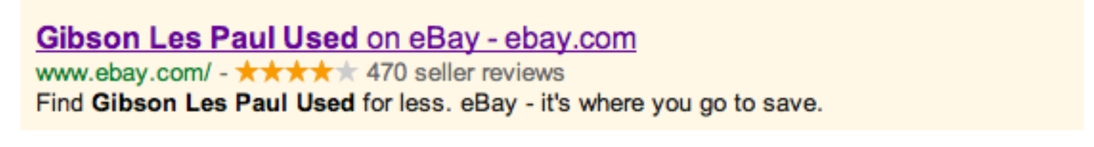
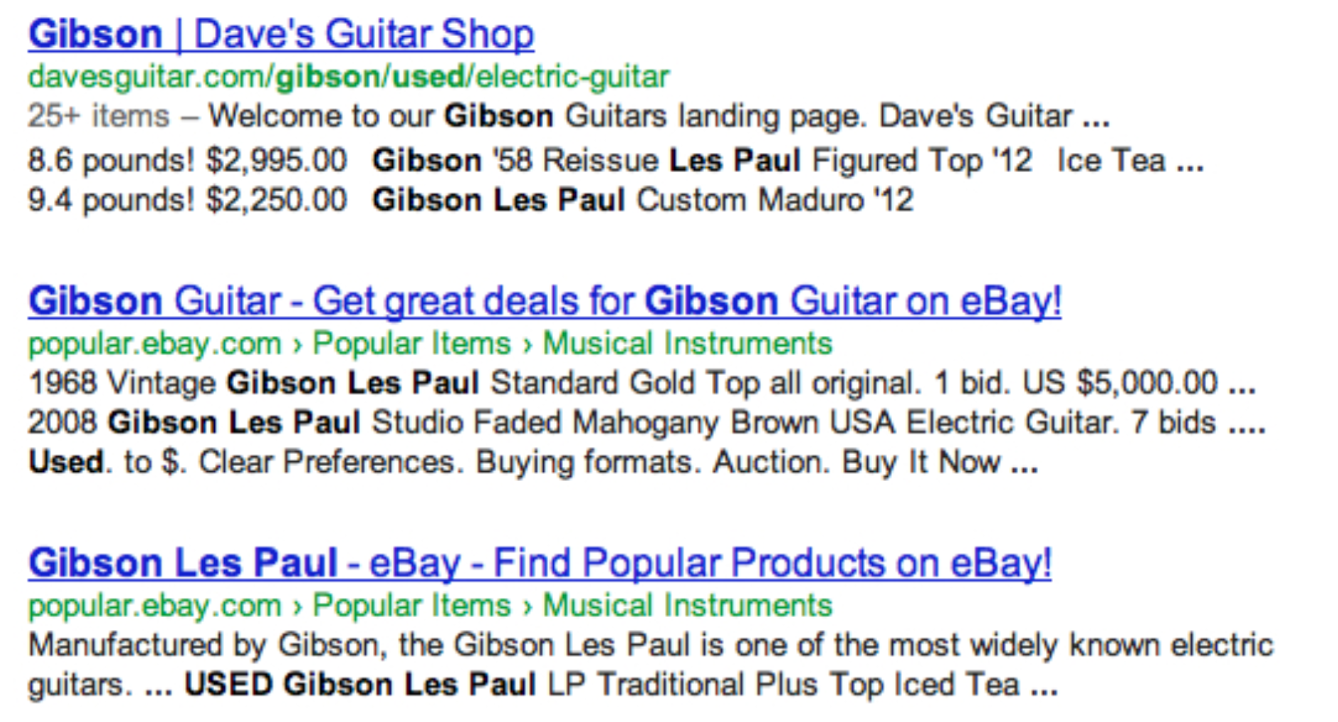
Measuring ROI for Search Ads
eBay brand ads, such as “ebay Gibson Les Paul?”
eBay Ad
Organic result
Source: Blake et al., Econometrica 2015

Slide 43
Naive ROI Analysis
ROI = (profit attributable to ad spend – ad spend) / ad spend
Only pay for ad when there is a click.
Profit per click (PPC) = $1.20
Cost per click (CPC) = $0.10
For each click (illustrative): ROI = (PPC – CPC) / CPC
= (1.2 – 0.1) / 0.1 = 1,100%
Q

Slide 46
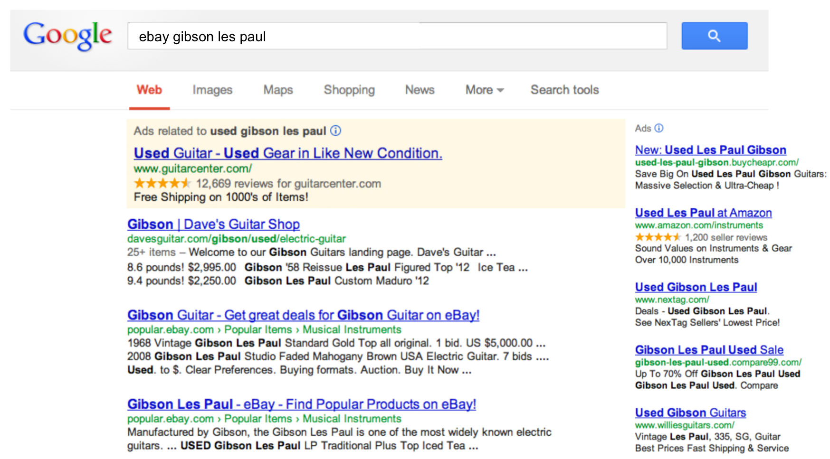
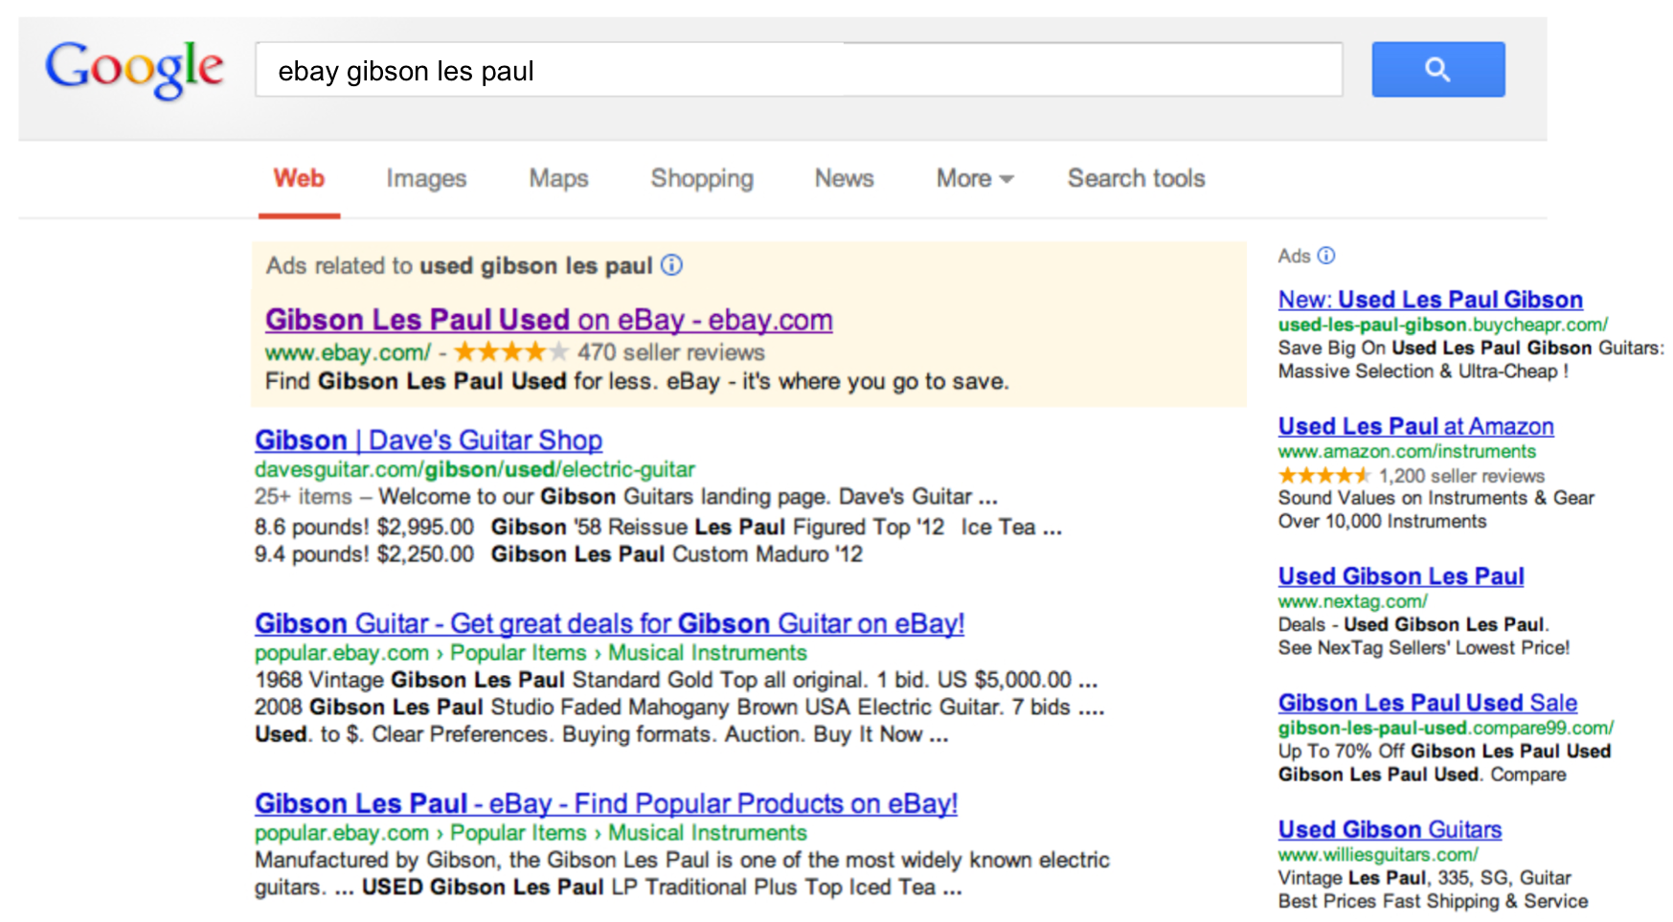
Paid Clicks May Not Be Incremental
No eBay Ad
eBay Ad
100
Paid clicks
+M
How many paid clicks would occur anyway?
200
200
Organic clicks
Organic clicks

Slide 47
Correct ROI Analysis
No Ads
Ads
Profit per click (PPC) = $1.20
Cost per click (CPC) = $0.10
100
Paid clicks
+M
Suppose M = 75.
Every 100 paid clicks generate only 25 incremental clicks.
200
200
Organic clicks
Cost per incremental click
CPIC = $0.10×(100/(100–75)) = $0.40
ROI = (PPC – CPIC) / CPIC = (1.2 – 0.4) / 0.4 = 200%

Slide 48
eBay Experiment (2012)
MSN Test (March 2012): stopped bidding on Bing (then MSN), while continuing to bid on Google (a control)
Results: 98.5% paid clicks retained through organic clicks
Google test (July 2012): similar results
Paid clicks replaced by organic clicks
Count of Clicks
Count of Clicks
01jan2012
08jan2012
15jan2012
22jan2012
29jan2012
05feb2012
12feb2012
19feb2012
26feb2012
04mar2012
11mar2012
18mar2012
25mar2012
01apr2012
08apr2012
15apr2012
22apr2012
29apr2012
06may2012
13may2012
20may2012
27may2012
03jun2012
10jun2012
17jun2012
24jun2012
01jun2012
08jun2012
15jun2012
22jun2012
29jun2012
06jul2012
13jul2012
20jul2012
27jul2012
03aug2012
10aug2012
17aug2012
24aug2012
31aug2012
07sep2012
14sep2012
MSN Paid
MSN Natural
Goog Natural
Goog Paid
Goog Natural
(a) MSN Test
(b) Google Test
Source: Blake et al., Econometrica 2015

Slide 49
eBay’s ROI on Search Ads
No Ads
Ads
CPC = $0.09; M = 98.5
Suppose PPC = $1.20
Naive ROI = (1.2–0.09) / 0.09 = 1,233%
98.5
100
Paid clicks
200
CPIC = (100 / (100 – 98.5)) × 0.09 = $6.00
200
Organic clicks
ROI = (1.2 – 6 ) / 6 = –80%
Also May 2012 experiment with nonbrand queries: e.g., “memory,” “used Gibson Les Paul?” Select 1/3 of geographic areas at random, pause ads: estimated M = 60, and a ROI of –63%
eBay stopped using sponsored search ads

Slide 50
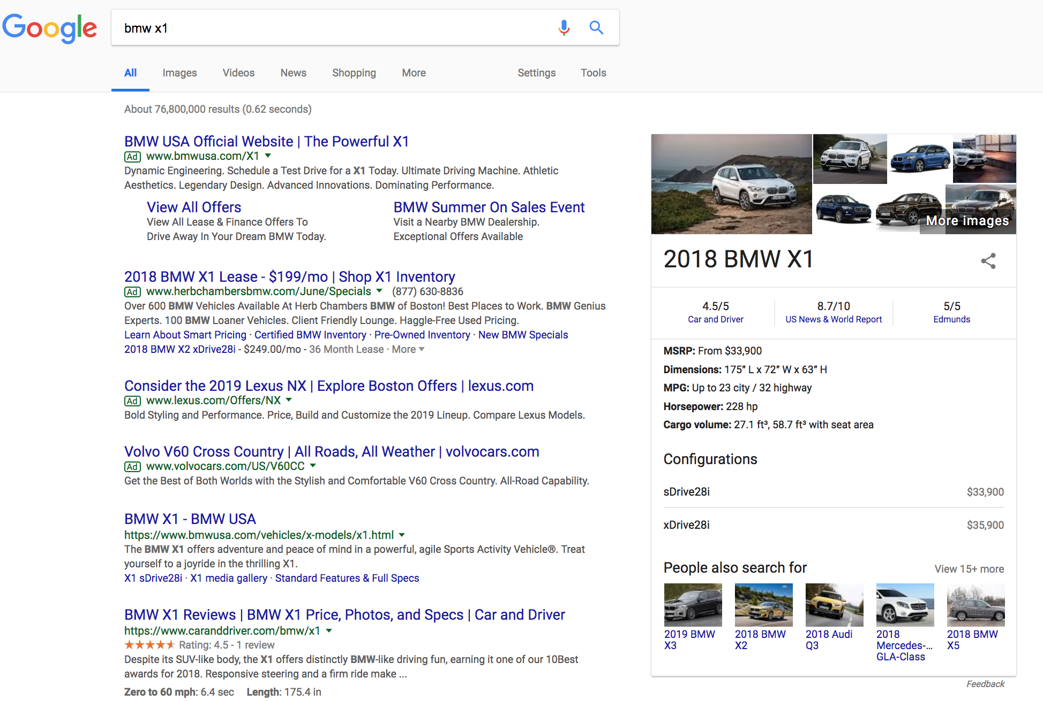
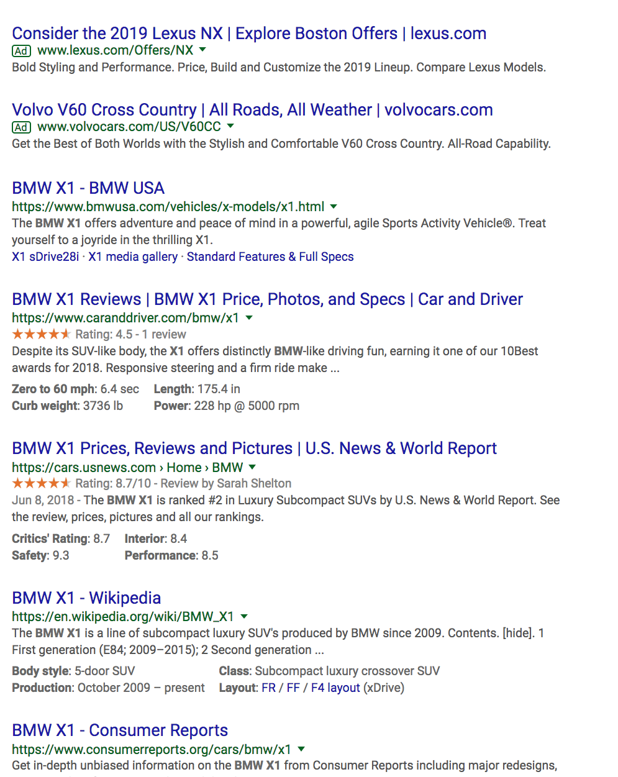
Another Look: Sponsored Search
Ads
Organic results
Source: google.com
Q

Slide 53
Competing Ads
Ad of focal brand
Competing ads
Organic result
Source: google.com

Slide 54
Competing Ads
Competitors “steal” approximately 18% of search traffic
Competitors “steal” approximately 2% of search traffic
No BMW Ad
With BMW Ad
POS 1
POS 3
POS 4
Source: google.com; Simonov, Nosko and Rao’18

Slide 55
Bing Experiment
Test ROI on Bing search ads for 1000 brands with own-brand competition. January, 2014, fraction of U.S. users.
Vary cap on number of ads
Placing Ads (800 firms;
BMW for example)
Not Placing Ads (200 firms; Toyota for example)
cap = 0
cap = 1
cap = 2
cap = 0
cap = 1
bmw
…
ad: bmw
ad: bmw
toyota
…
ad: lexus
organic
bmw
…
ad: lexus
organic
toyota
…
organic
organic
bmw
…
organic
Δ click (no competition)
Δ click (competition)
Source: Simonov, Nosko and Rao’18

Slide 56
Result Bing Experiment: High ROI
No competition
Own-brand competition
No Ad
Ad
No Ad
Ad
94
100
Paid clicks
100
Paid clicks
65
117
117
Organic clicks
62
62
Organic clicks
CPC = $0.09; PPC = $1.20
CPIC = 100 / (100-94) × CPC
= $1.50
CPIC = 100 / (100-65) × CPC
= $0.26
When a firm piggy-backs off the brand awareness of another, this creates high ROI for defensive bidding

Slide 58
Attribution

Slide 59
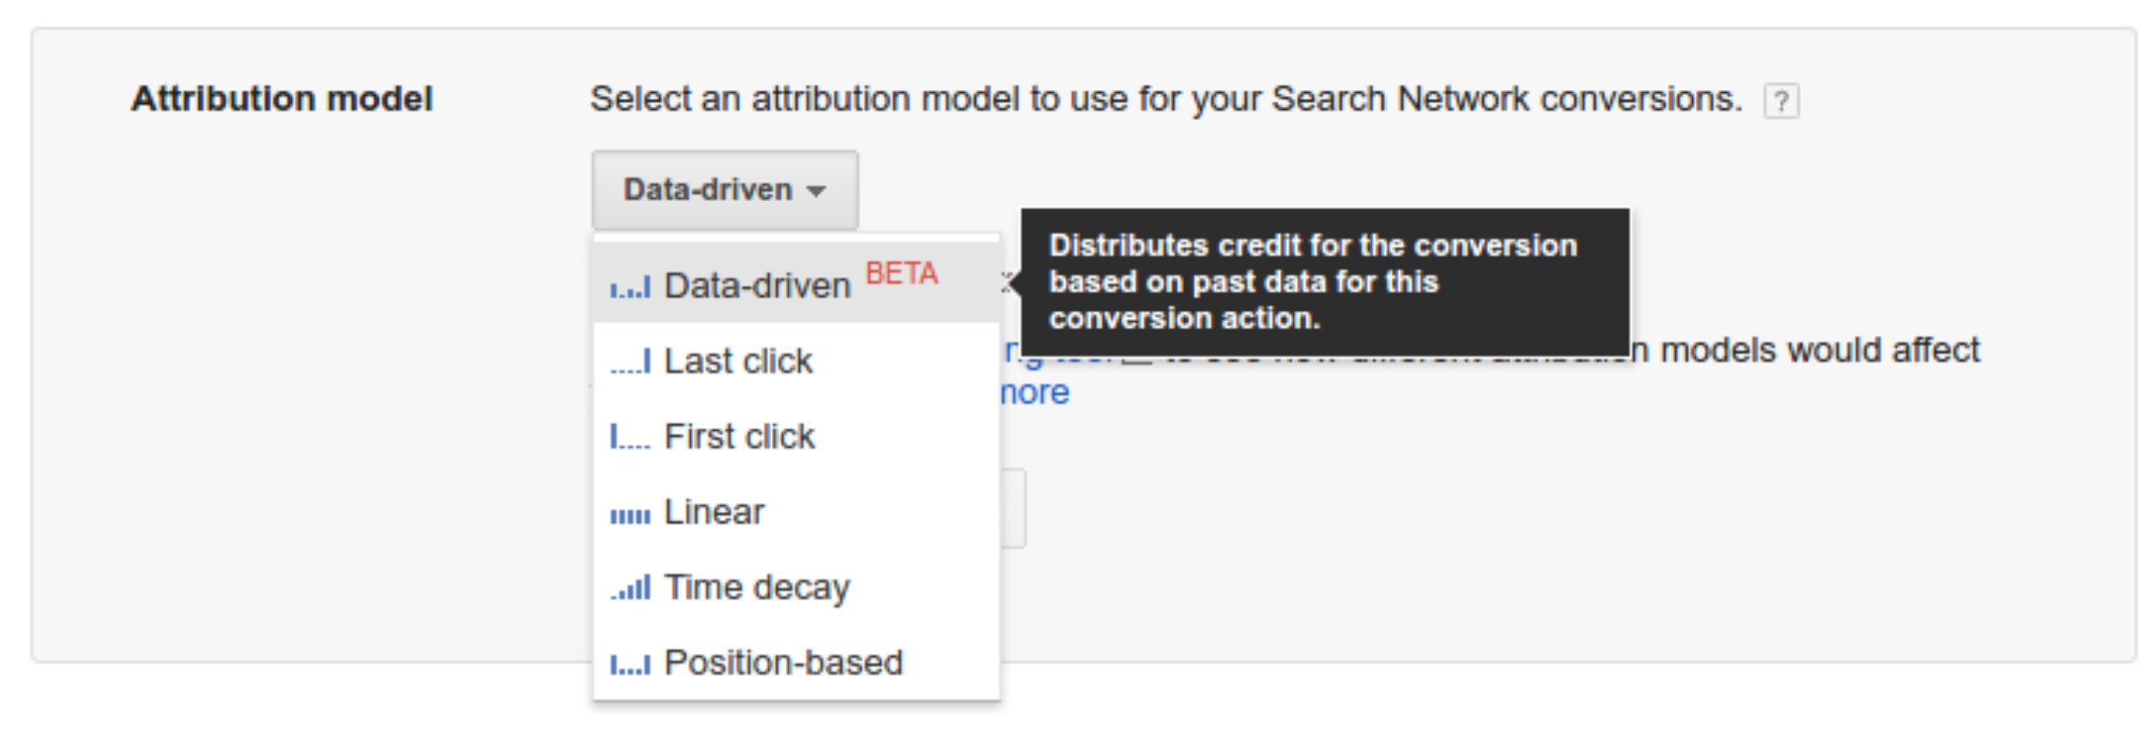
Attribution Methods
New challenge: user conversions are affected by multiple ads, following different paths (e.g., display → social → search → retarget → purchase)
How to attribute credit to each touch point?
Source: Google
V

Slide 62
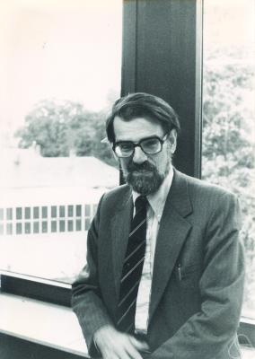
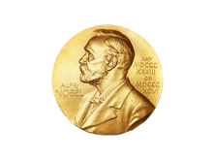
Sharing Credit for Team Work
Question: How to credit the value ($1) generated by a team {1,2,3} to each individual?
Determine how much value each subgroup would generate:
v({3}) = $0
v({1,3}) = $0.50
v({1}) = $0.40
v({2,3}) = $0.20 …
For each individual i, and each possible sequence of team members, calculate the marginal contribution of i:
Sequence (1,2,3). MC of 1 is v({1}) – 0 = 0.4
Sequence (3,1,2). MC of 1 is v({1,3}) – v({3}) = 0.5
… …
Shapley Value for person i is the average marginal contribution of i across all sequences
2012
Source: https://commons.wikimedia.org/w/index.php?curid=4998292

Slide 63
Shapley-Based Fair Attribution
Estimate value of each channel by itself
Calculate marginal contributions for every path through channels
Channel | Conversion Rate
 | 3%
 | 4%
 | 10%
Path | Channel 1 | Channel 2 | Channel 3
1
 | 3% | 6% | 15%
2
 | 3% | 12% | 9%
3
 | 4% | 13% | 7%
4
 | 4% | 5% | 15%
5
 | 10% | 7% | 7%
6
 | 10% | 5% | 9%
Social Network
Paid Search
Email
Social Network
Paid Search
Social Network
Email
Paid Search
Email
Paid Search
Email
Social Network
Estimate total value for each set of channels
Paid Search
Social Network
Email
Email
Paid Search
Social Network
Channel Set | Conversion Rate
{ , } | 9%
{ , } | 15%
{ , } | 17%
{ , , } | 24%
Email
Social Network
Paid Search
Social Network
Paid Search
Calculate average marginal contributions
Social Network
Email
Channel Path | Σ of incremental CR | Average CR
 | 3%+3%+7%+5%+7%+5% |  | 5%
 | 6%+9%+4%+4%+7%+9% |  | 6.5%
 | 15%+12%+13%+15%+10%+10% |  | 12.5%
Paid Search
Email
Social Network
Social Network
Paid Search
Email
Paid Search
Email
https://www.smartly.io/blog/data-driven-attribution-101-how-it-helps-incrementality-testing-and-lookback-windows

Slide 64
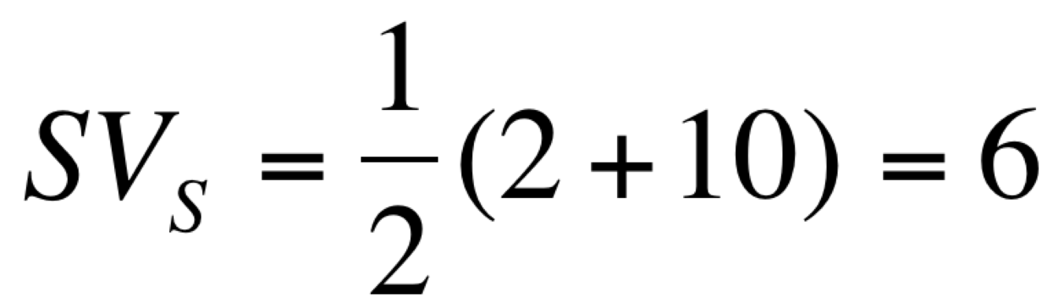
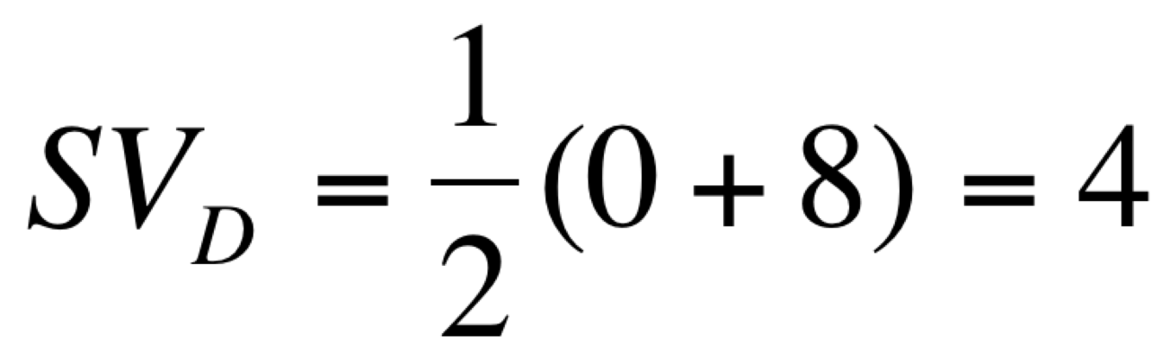
Can Assign Credit Early in Funnel
Shapley Value can attribute credit to ads early in the marketing funnel
{Display} 0%
{Search} 2%
{Display, Search} 10%
Display ads receive attribution, even if search ads are last touch before purchase

Slide 66
Measuring Offline ROI

Slide 67
Major American Department Store
Fall 2007: experiment at Yahoo to understand effect of display ads on sales
1.6 million users, matched by name and email or address to existing customers
Randomized design: 81% in treatment and 19% in control (no ads from merchant)
Results: a 5% increase in sales (93% of these offline), with a significant, positive ROI

Slide 68
Effect on Two Week Sales
Distribution of Two-Week Sales
0.020
0.018
0.016
0.014
0.012
Promising effects
Fraction of Group
0.010
0.008
0.006
0.004
0.002
0.000
-100
-60
-20
20
60
100
140
180
220
260
300
340
380
Two-Week Sales
Treatment Density
Control Density
Cost R$ 0.02 / user (normalized currency)
Source: Lewis and Reiley ‘14

Slide 69
Estimating Offline ROI
Coin flip
Control
Targeted ad
1.842
1.894
Unreachable
Reachable
(frac)
(1-frac)
No ad
Ad
No ad
Ad
2.042
$$_{B}
1.811
ATET
Intent to treat vs not: R$ +0.052/user
Estimate $$_{B}: assume 1.842 = frac ⨉ (2.042) + (1-frac) ⨉ $$_{B} $$_{B} = 1.73; ATET = R$ +0.081/user

Slide 71
Experiments, Generally

Slide 72
Experimentation Platform at Bing
The Growth of Experimentation at Bing
350
300
Growth takes off once the experimentation platform allows a user to take part in multiple experiments at the same time, supporting virtually unlimited concurrent tests
250
200
COMPLETED EXPERIMENT
TREATMENTS PER WEEK
150
100
50
0
2008
2009
2010
2011
2012
2013
2014
FROM “THE SURPRISING POWER OF ONLINE EXPERIMENTS,” SEPTEMBER-OCTOBER 2017, BY RON KOHAVI AND STEFAN THOMKE
© HBR.ORG

Slide 73
Twyman’s Law
“Any figure that looks interesting or different is usually wrong.”
R. Kohavi, after “The Teaching of Statistics” , A. S. C. Ehrenberg, Journal of the Royal Statistical Society (1975), after W. A. Twyman.

Slide 74
A Successful Experiment
Bing, 2013: text color on search results page
Results unexpectedly positive: users succeeding more, and doing so more quickly
Viewed with skepticism (Twyman’s!): confirmed with sample of 32 million users
Estimated to increase revenue by $10 million annually
Control color
Treatment color
FROM “THE SURPRISING POWER OF ONLINE EXPERIMENTS,” SEPTEMBER-OCTOBER 2017, BY RON KOHAVI AND STEFAN THOMKE
© HBR.ORG
Lesson 1: surprising results should be replicated

Slide 75
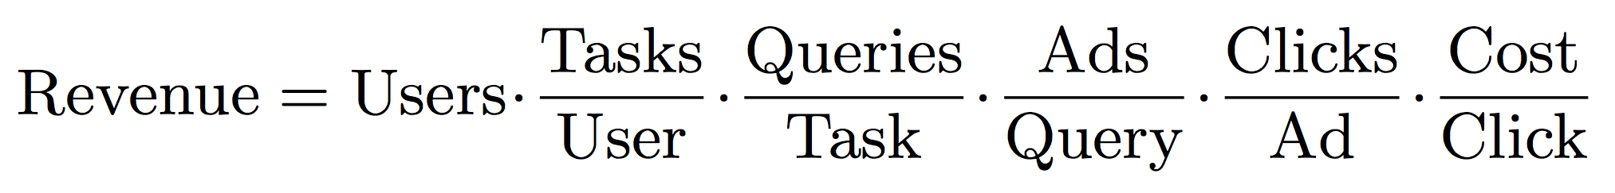
Long-Term vs. Short-Term
Google Revenue
Reduce search quality?
Increase Ad load?
Long-term decrease
Increase
Short-term increase
Short- and long-term decrease
Lesson 2: be careful about evaluation criteria
Lesson 3: run long-run experiments where needed
Source: Hohnhold, O’Brien and Tang’15

Slide 76
Long-Run Experiment: Ad Load
What is the effect of increased mobile ad load?
2013 experiment at Google increased load, deploying treatment to a new cohort each week
Short-term revenue positive
RPM
Long-term revenue neutral
0
0
50
100
150
200
Treatment duration in days
Revenue = Users
Tasks
Queries
Ads
Clicks
Cost
User
Task
Query
Ad
Click
Source: Hohnhold, O’Brien and Tang’15

Slide 77
Long-Run Experiment: Ad Load
What is the effect of decreased mobile ad load?
Experiment at Google reduced ad load 50%, deploy weekly to new cohort
Ad sightedness: how users’ inherent propensity to click on ads changes
CTR (in percent)
18
17
Improved Ad sightedness
16
15
Instantaneous quality gain
14
03-05
03-09
03-13
03-17
03-21
03-25
03-29
04-02
04-06
04-10
04-14
04-18
04-22
04-26
04-30
05-04
05-08
05-12
05-16
05-20
Source: Hohnhold, O’Brien and Tang’15

Slide 78
Long-Run Experiment: Audio Ads
2014–2016 experiment: 35 million Pandora Internet radio listeners 3x3 design: 3, 4, or 6 interrupts/hour; 1, 1.5, or 2 ads per interrupt
102
Long-run effect on number of hours listened
100
Hours listened each week
98
Aug-14
Nov-14
Feb-15
May-15
Aug-15
Nov-15
Feb-16
May-16
Time
Lowest Ad Load
Highest Ad Load
Source: Huang, Reiley and Riabov’17

Slide 79
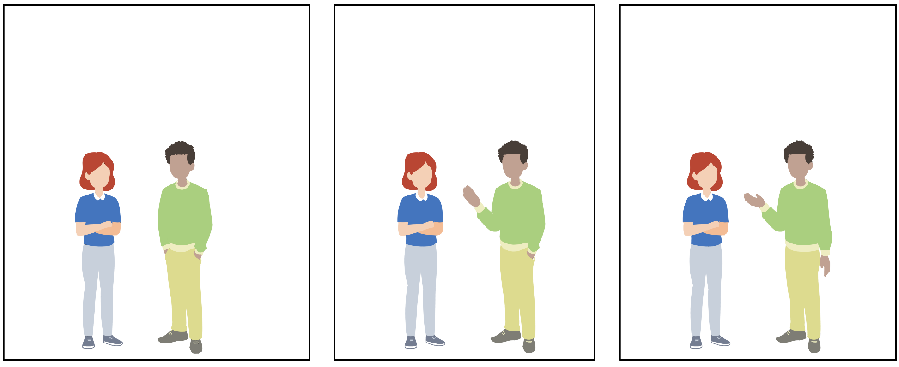
Don’t Forget About Causality
I USED TO THINK CORRELATION IMPLIED CAUSATION.
THEN I TOOK A STATISTICS CLASS.
NOW I DON'T.
SOUNDS LIKE THE CLASS HELPED.
WELL, MAYBE.
https://xkcd.com/552/

